Slide 1
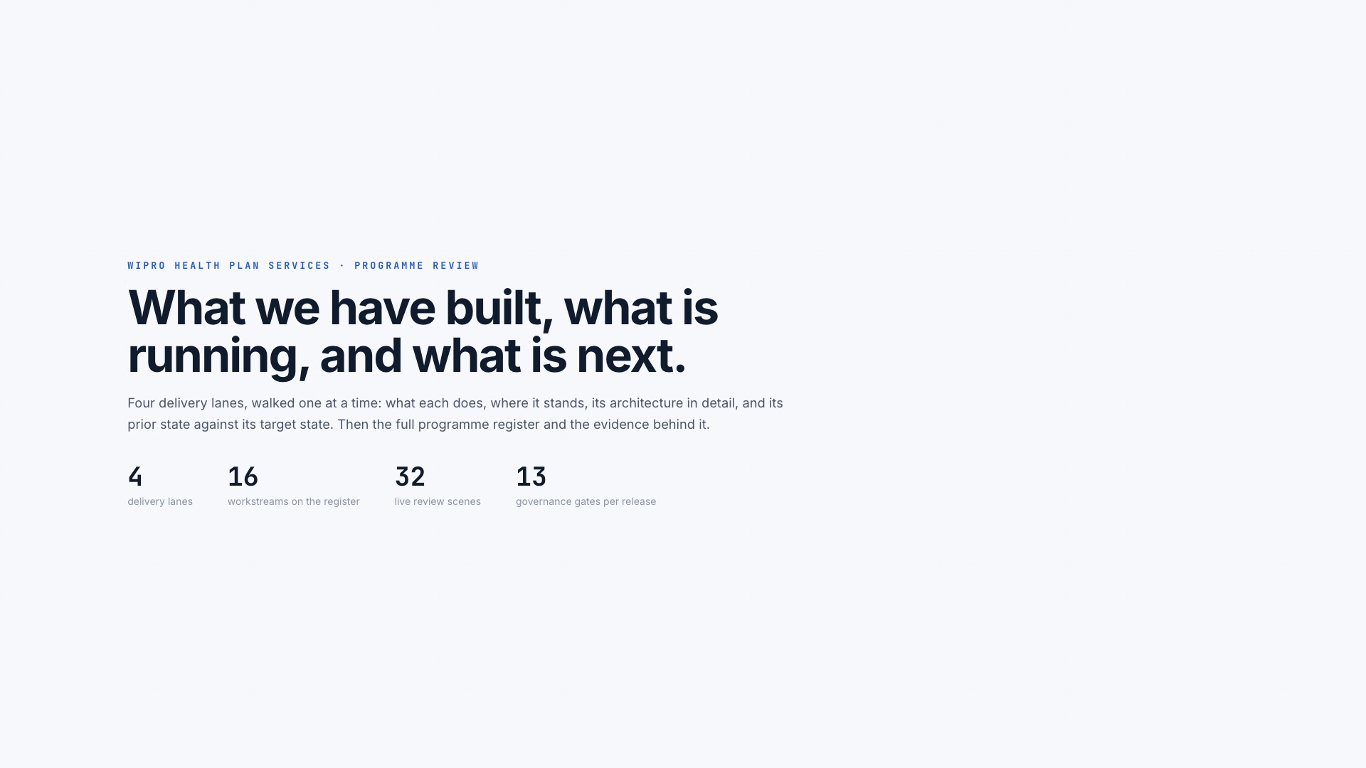
Notes:
[Sources]
- Web presentation slide 1 of 32: /ai-factory-leadership-review.html#cover
- WHPS AI Transformation programme-owner record: repository CLAUDE.md

Slide 2
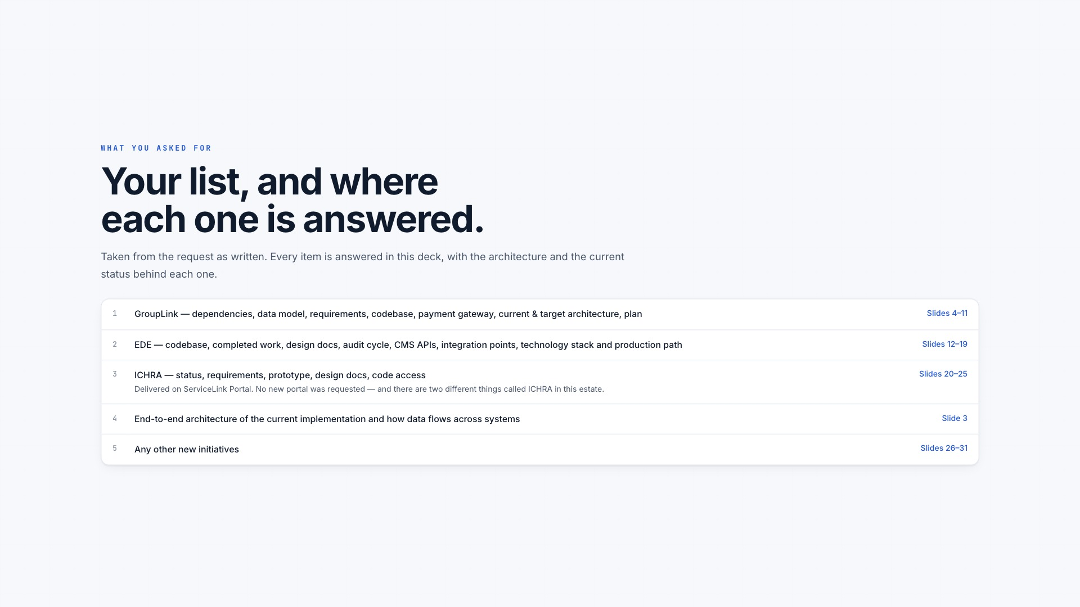
Notes:
[Sources]
- Web presentation slide 2 of 32: /ai-factory-leadership-review.html#map
- WHPS AI Transformation programme-owner record: repository CLAUDE.md

Slide 3
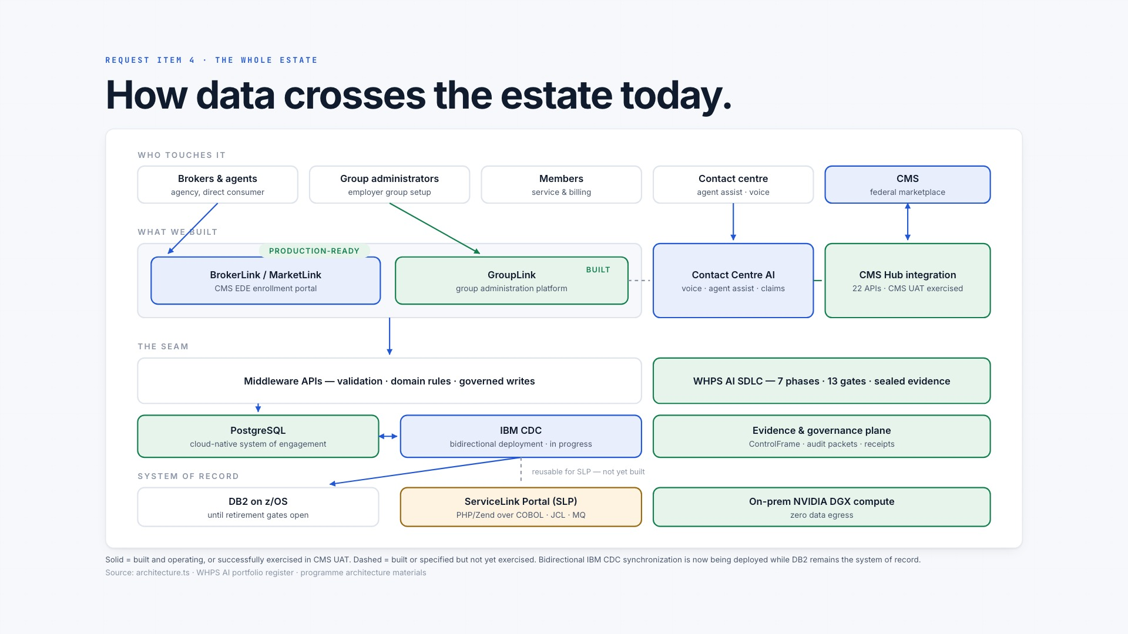
Notes:
[Sources]
- Web presentation slide 3 of 32: /ai-factory-leadership-review.html#e2e
- WHPS AI Transformation programme-owner record: repository CLAUDE.md

Slide 4
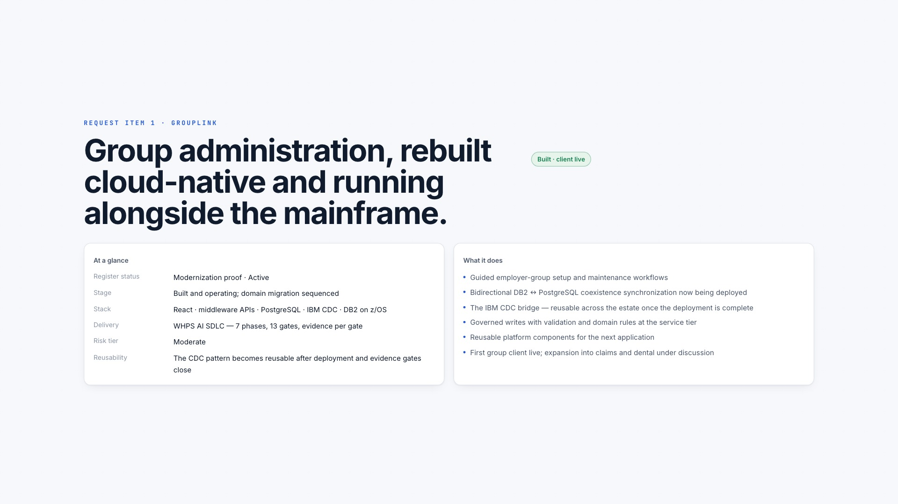
Notes:
[Sources]
- Web presentation slide 4 of 32: /ai-factory-leadership-review.html#gl-overview
- WHPS AI Transformation programme-owner record: repository CLAUDE.md
- WHPS GroupLink architecture and integration record in this repository

Slide 5
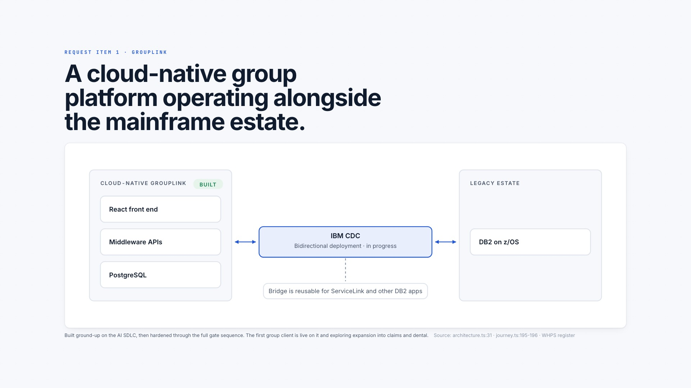
Notes:
[Sources]
- Web presentation slide 5 of 32: /ai-factory-leadership-review.html#gl-what
- WHPS AI Transformation programme-owner record: repository CLAUDE.md
- WHPS GroupLink architecture and integration record in this repository

Slide 6
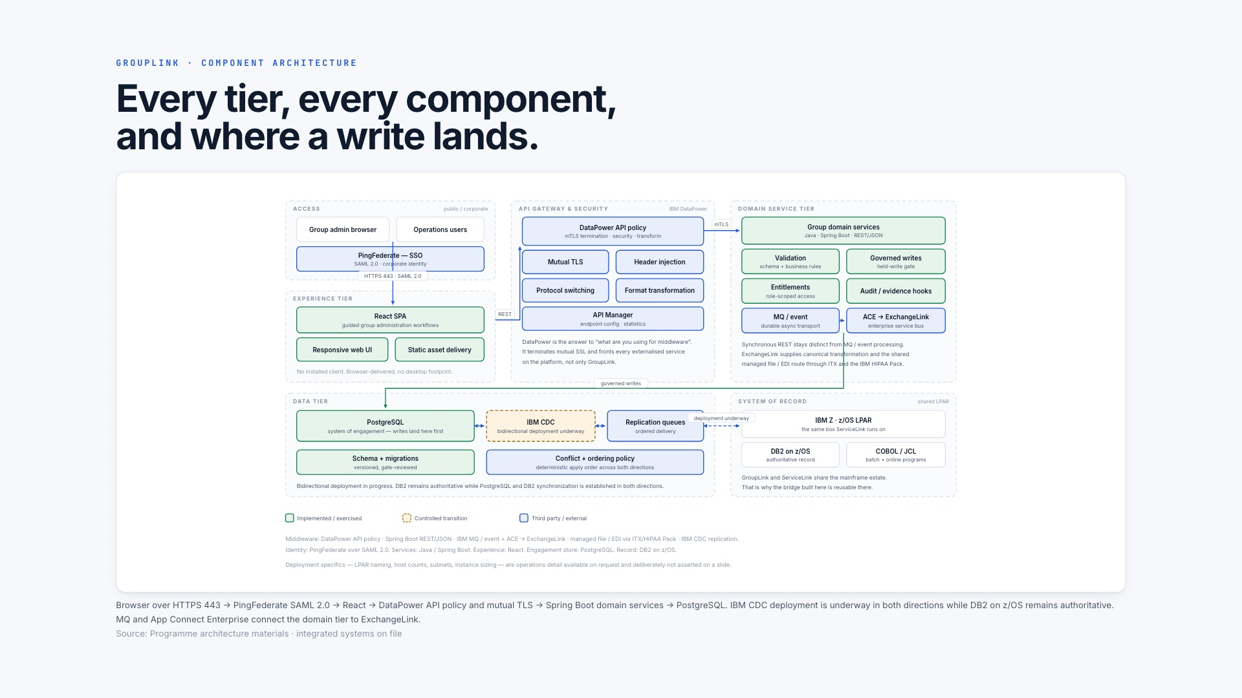
Notes:
[Sources]
- Web presentation slide 6 of 32: /ai-factory-leadership-review.html#gl-arch
- WHPS AI Transformation programme-owner record: repository CLAUDE.md
- WHPS GroupLink architecture and integration record in this repository

Slide 7
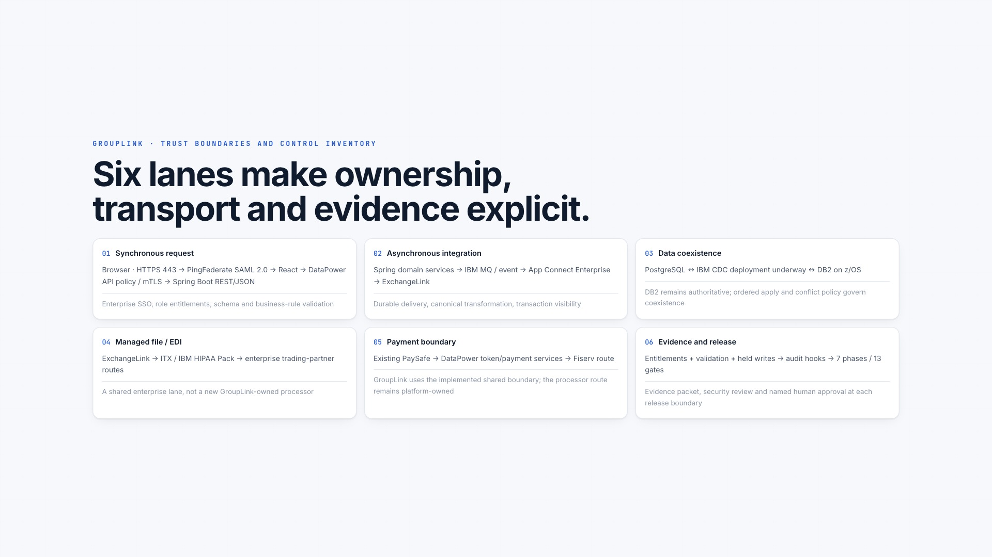
Notes:
[Sources]
- Web presentation slide 7 of 32: /ai-factory-leadership-review.html#gl-stack
- WHPS AI Transformation programme-owner record: repository CLAUDE.md
- WHPS GroupLink architecture and integration record in this repository

Slide 8
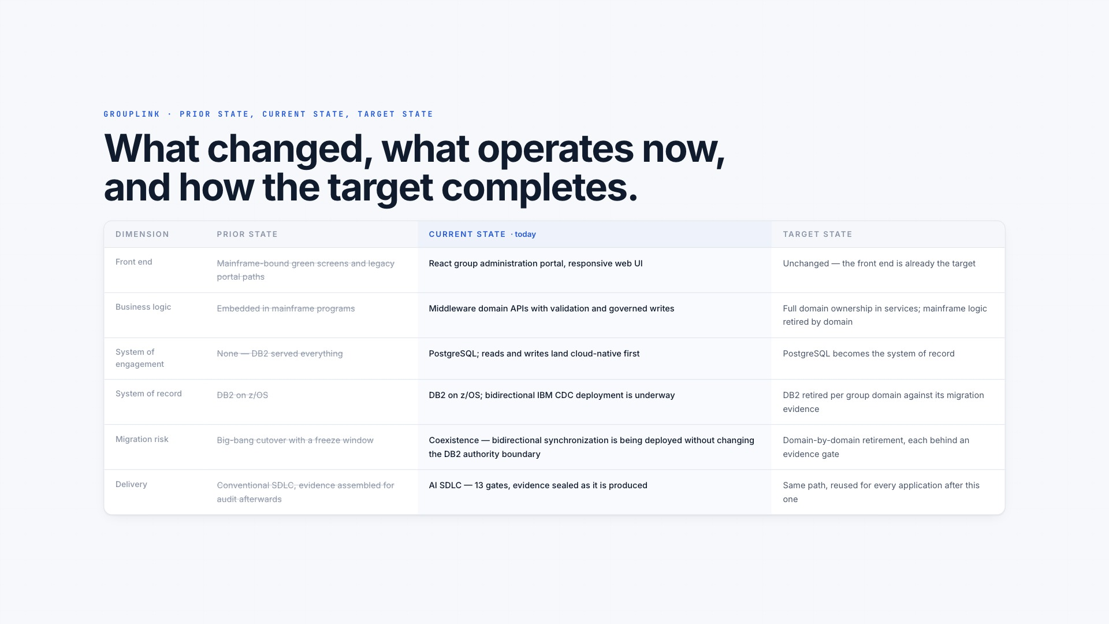
Notes:
[Sources]
- Web presentation slide 8 of 32: /ai-factory-leadership-review.html#gl-shift
- WHPS AI Transformation programme-owner record: repository CLAUDE.md
- WHPS GroupLink architecture and integration record in this repository

Slide 9
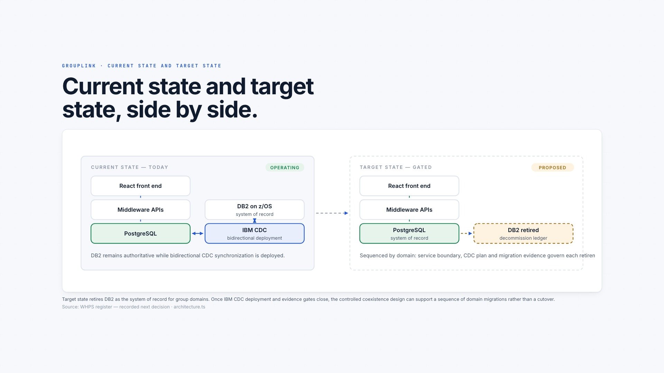
Notes:
[Sources]
- Web presentation slide 9 of 32: /ai-factory-leadership-review.html#gl-states
- WHPS AI Transformation programme-owner record: repository CLAUDE.md
- WHPS GroupLink architecture and integration record in this repository

Slide 10

Notes:
[Sources]
- Web presentation slide 10 of 32: /ai-factory-leadership-review.html#gl-timeline
- WHPS AI Transformation programme-owner record: repository CLAUDE.md
- WHPS GroupLink architecture and integration record in this repository

Slide 11
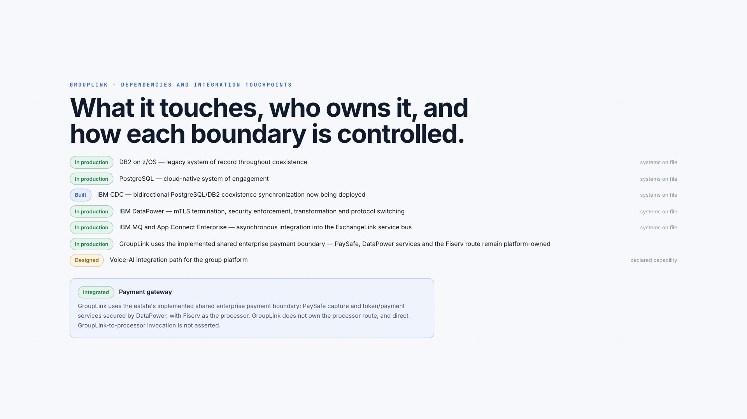
Notes:
[Sources]
- Web presentation slide 11 of 32: /ai-factory-leadership-review.html#gl-integrations
- WHPS AI Transformation programme-owner record: repository CLAUDE.md
- WHPS GroupLink architecture and integration record in this repository

Slide 12
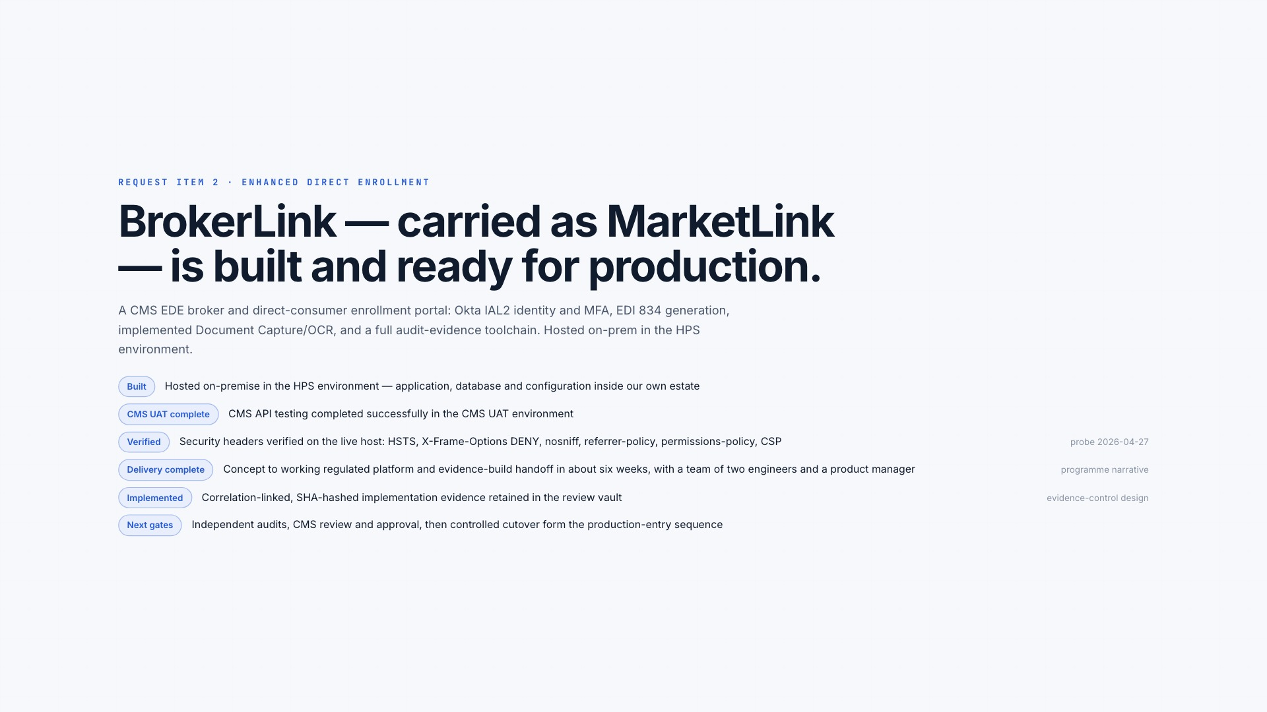
Notes:
[Sources]
- Web presentation slide 12 of 32: /ai-factory-leadership-review.html#ede-what
- WHPS AI Transformation programme-owner record: repository CLAUDE.md
- CMS Year 9 Enhanced Direct Enrollment audit guidelines (April 10, 2026): https://www.cms.gov/files/document/guidelines-enhanced-direct-enrollment-audits-year-9-final.pdf
- CMS Enhanced Direct Enrollment partners: https://www.cms.gov/marketplace-private-insurance/agents-brokers/direct-enrollment-partners
- MarketLink implementation snapshot: WHPS MarketLink source repository, 2026-07-20

Slide 13
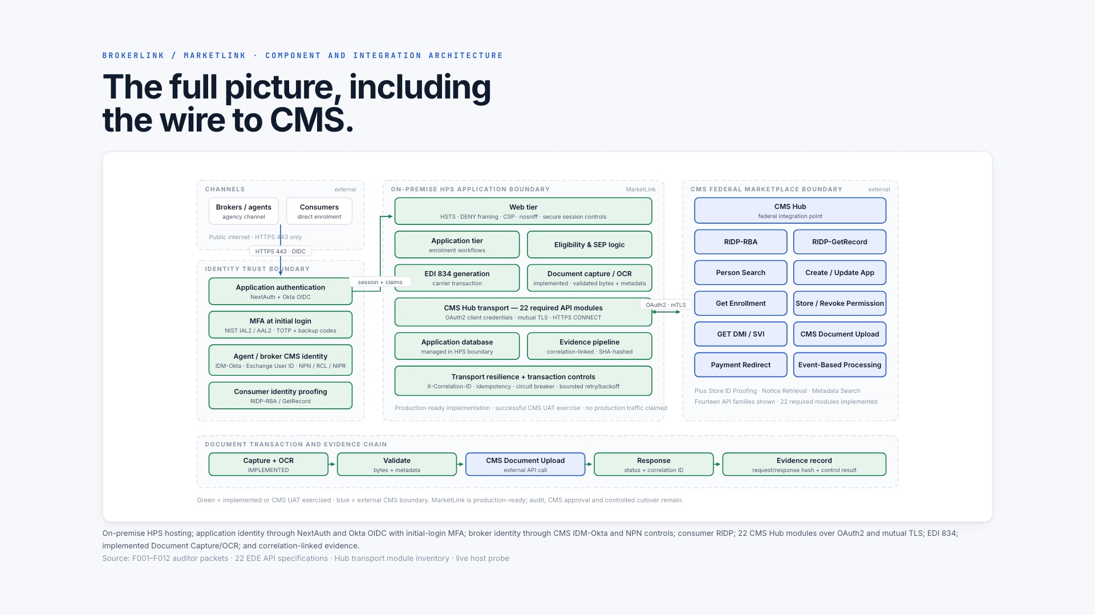
Notes:
[Sources]
- Web presentation slide 13 of 32: /ai-factory-leadership-review.html#ede-arch
- WHPS AI Transformation programme-owner record: repository CLAUDE.md
- CMS Year 9 Enhanced Direct Enrollment audit guidelines (April 10, 2026): https://www.cms.gov/files/document/guidelines-enhanced-direct-enrollment-audits-year-9-final.pdf
- CMS Enhanced Direct Enrollment partners: https://www.cms.gov/marketplace-private-insurance/agents-brokers/direct-enrollment-partners
- MarketLink implementation snapshot: WHPS MarketLink source repository, 2026-07-20

Slide 14
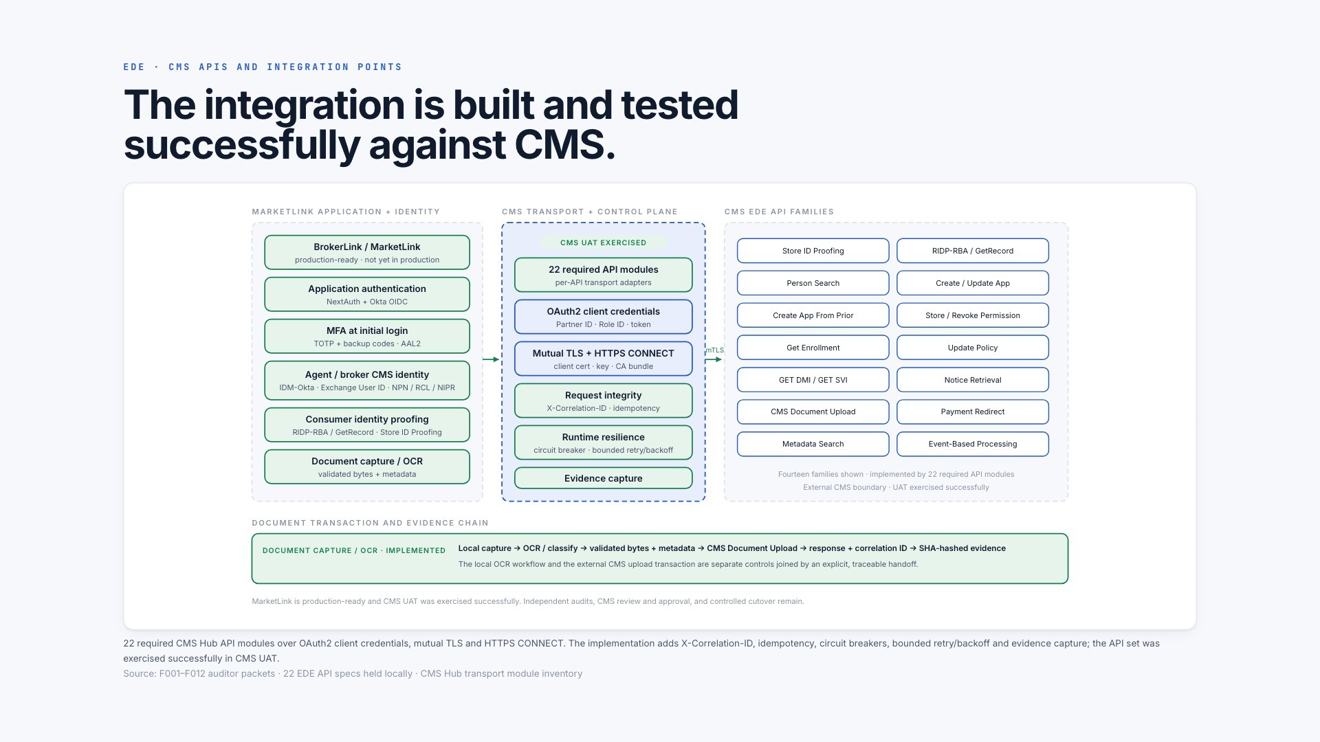
Notes:
[Sources]
- Web presentation slide 14 of 32: /ai-factory-leadership-review.html#ede-apis
- WHPS AI Transformation programme-owner record: repository CLAUDE.md
- CMS Year 9 Enhanced Direct Enrollment audit guidelines (April 10, 2026): https://www.cms.gov/files/document/guidelines-enhanced-direct-enrollment-audits-year-9-final.pdf
- CMS Enhanced Direct Enrollment partners: https://www.cms.gov/marketplace-private-insurance/agents-brokers/direct-enrollment-partners
- MarketLink implementation snapshot: WHPS MarketLink source repository, 2026-07-20

Slide 15
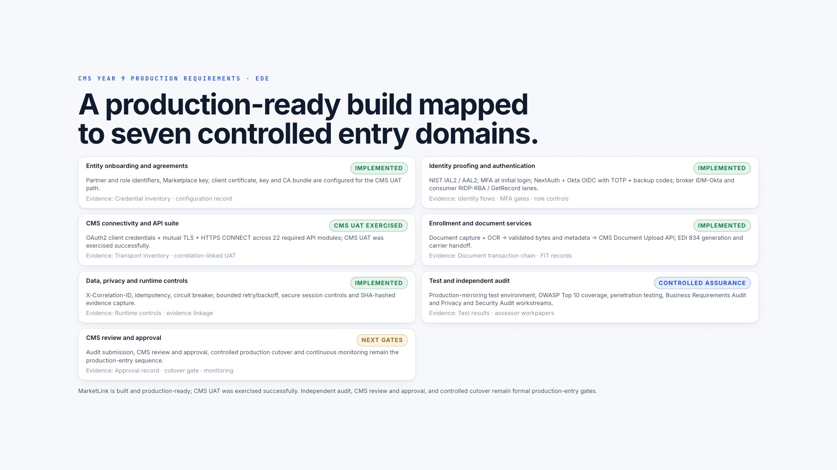
Notes:
[Sources]
- Web presentation slide 15 of 32: /ai-factory-leadership-review.html#ede-requirements
- WHPS AI Transformation programme-owner record: repository CLAUDE.md
- CMS Year 9 Enhanced Direct Enrollment audit guidelines (April 10, 2026): https://www.cms.gov/files/document/guidelines-enhanced-direct-enrollment-audits-year-9-final.pdf
- CMS Enhanced Direct Enrollment partners: https://www.cms.gov/marketplace-private-insurance/agents-brokers/direct-enrollment-partners
- MarketLink implementation snapshot: WHPS MarketLink source repository, 2026-07-20

Slide 16
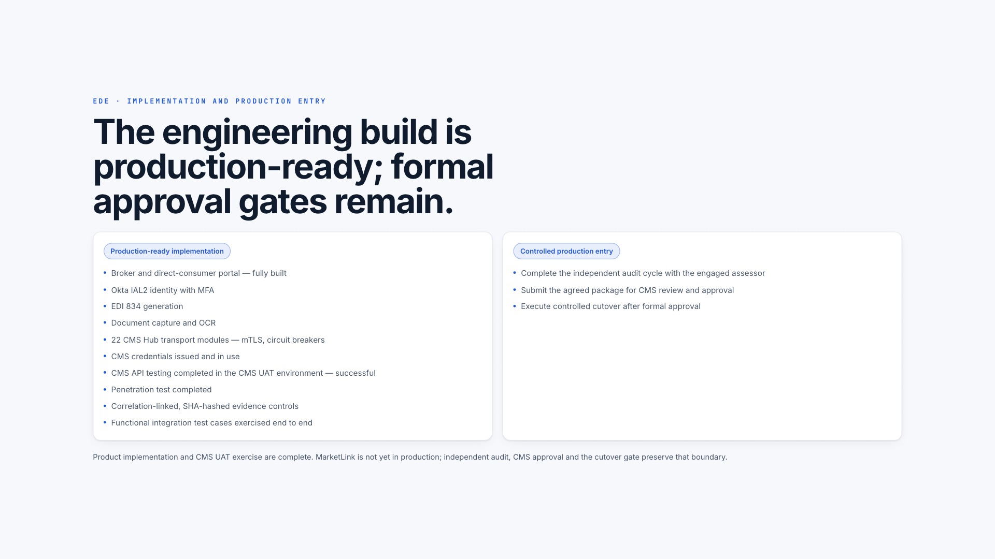
Notes:
[Sources]
- Web presentation slide 16 of 32: /ai-factory-leadership-review.html#ede-status
- WHPS AI Transformation programme-owner record: repository CLAUDE.md
- CMS Year 9 Enhanced Direct Enrollment audit guidelines (April 10, 2026): https://www.cms.gov/files/document/guidelines-enhanced-direct-enrollment-audits-year-9-final.pdf
- CMS Enhanced Direct Enrollment partners: https://www.cms.gov/marketplace-private-insurance/agents-brokers/direct-enrollment-partners
- MarketLink implementation snapshot: WHPS MarketLink source repository, 2026-07-20

Slide 17
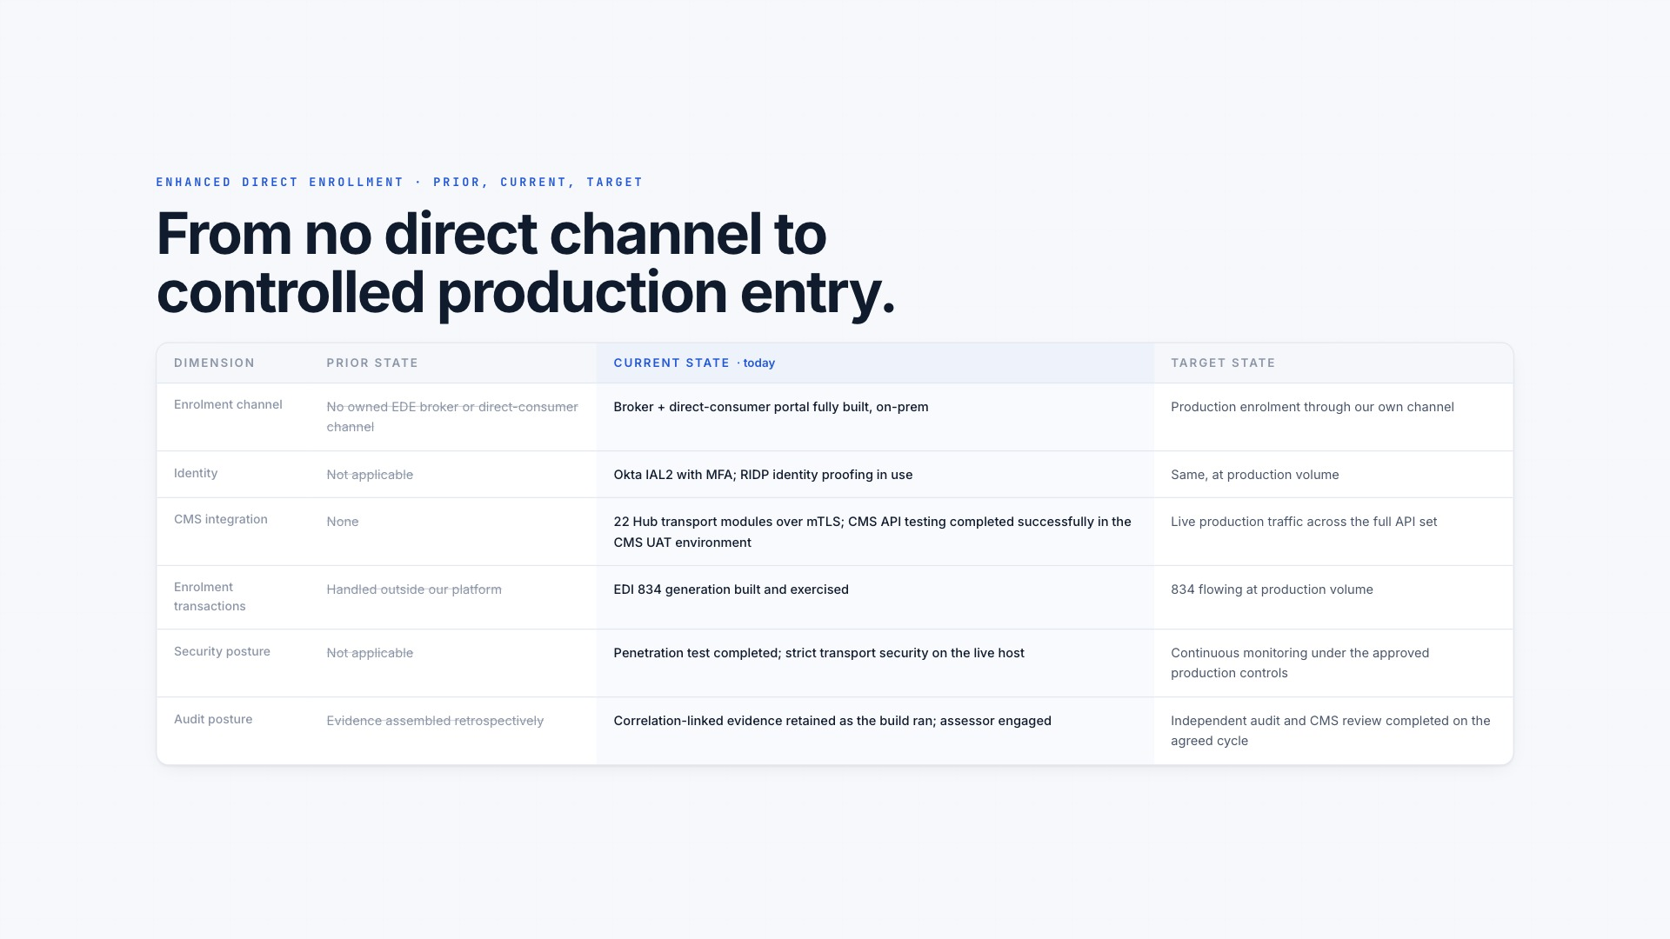
Notes:
[Sources]
- Web presentation slide 17 of 32: /ai-factory-leadership-review.html#ede-shift
- WHPS AI Transformation programme-owner record: repository CLAUDE.md
- CMS Year 9 Enhanced Direct Enrollment audit guidelines (April 10, 2026): https://www.cms.gov/files/document/guidelines-enhanced-direct-enrollment-audits-year-9-final.pdf
- CMS Enhanced Direct Enrollment partners: https://www.cms.gov/marketplace-private-insurance/agents-brokers/direct-enrollment-partners
- MarketLink implementation snapshot: WHPS MarketLink source repository, 2026-07-20

Slide 18
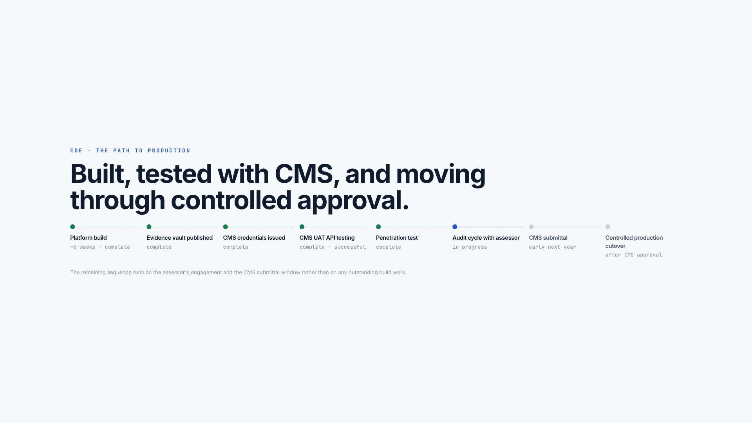
Notes:
[Sources]
- Web presentation slide 18 of 32: /ai-factory-leadership-review.html#ede-timeline
- WHPS AI Transformation programme-owner record: repository CLAUDE.md
- CMS Year 9 Enhanced Direct Enrollment audit guidelines (April 10, 2026): https://www.cms.gov/files/document/guidelines-enhanced-direct-enrollment-audits-year-9-final.pdf
- CMS Enhanced Direct Enrollment partners: https://www.cms.gov/marketplace-private-insurance/agents-brokers/direct-enrollment-partners
- MarketLink implementation snapshot: WHPS MarketLink source repository, 2026-07-20

Slide 19
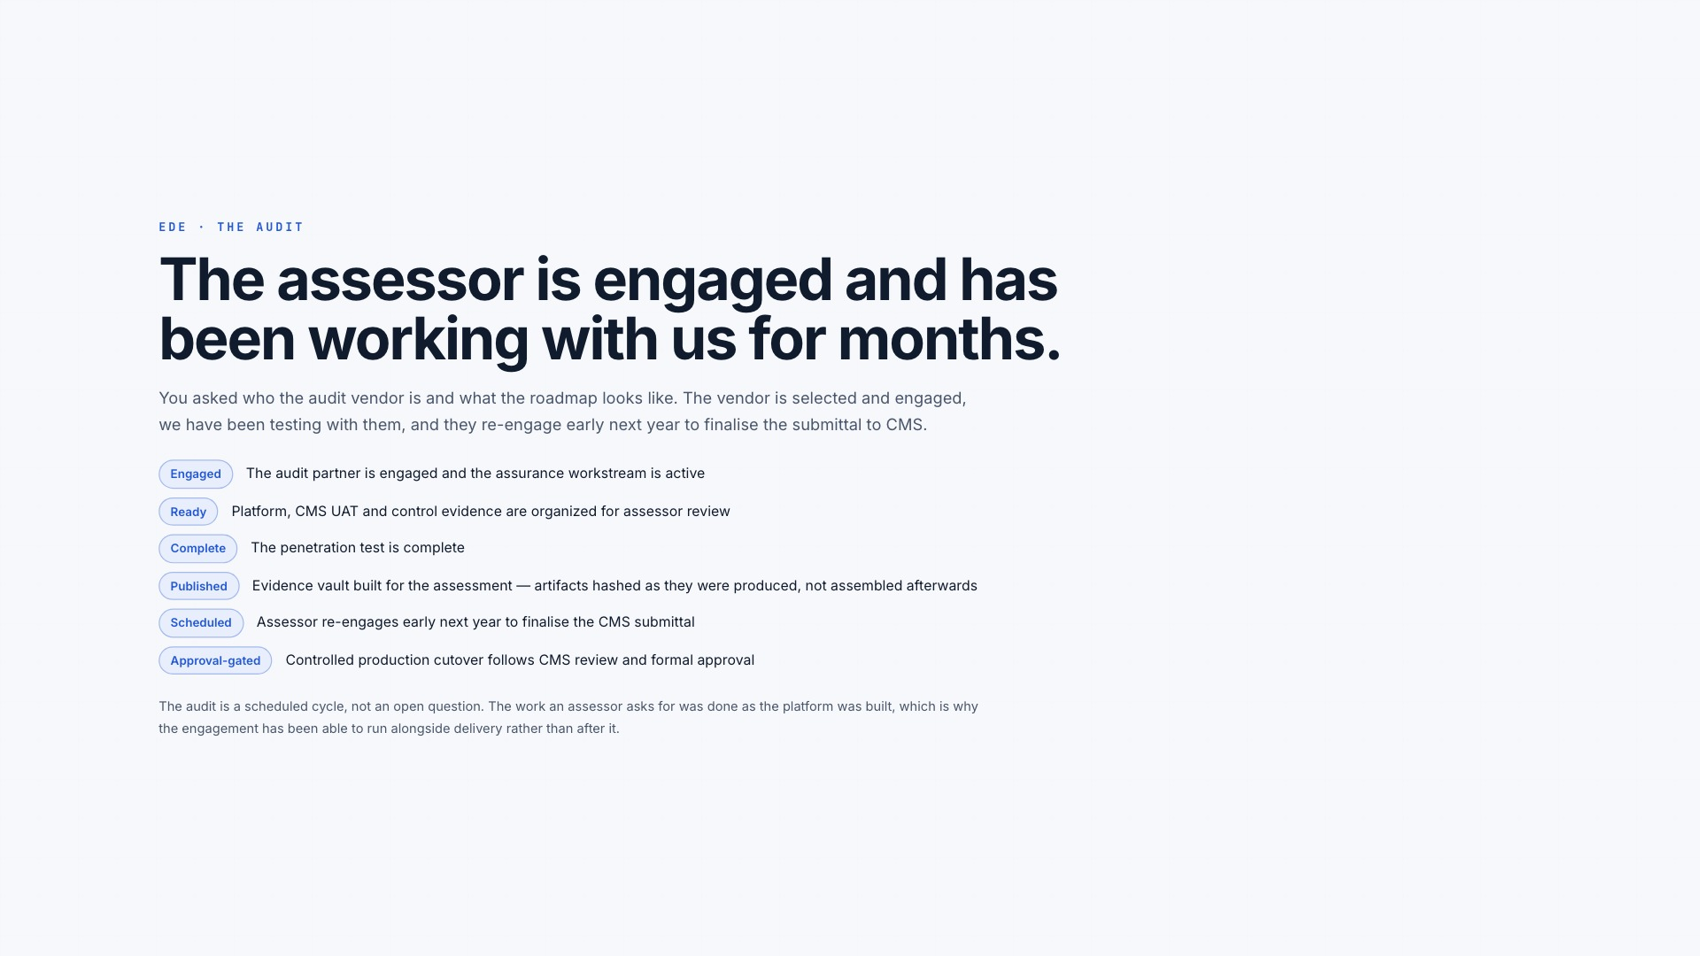
Notes:
[Sources]
- Web presentation slide 19 of 32: /ai-factory-leadership-review.html#ede-audit
- WHPS AI Transformation programme-owner record: repository CLAUDE.md
- CMS Year 9 Enhanced Direct Enrollment audit guidelines (April 10, 2026): https://www.cms.gov/files/document/guidelines-enhanced-direct-enrollment-audits-year-9-final.pdf
- CMS Enhanced Direct Enrollment partners: https://www.cms.gov/marketplace-private-insurance/agents-brokers/direct-enrollment-partners
- MarketLink implementation snapshot: WHPS MarketLink source repository, 2026-07-20

Slide 20
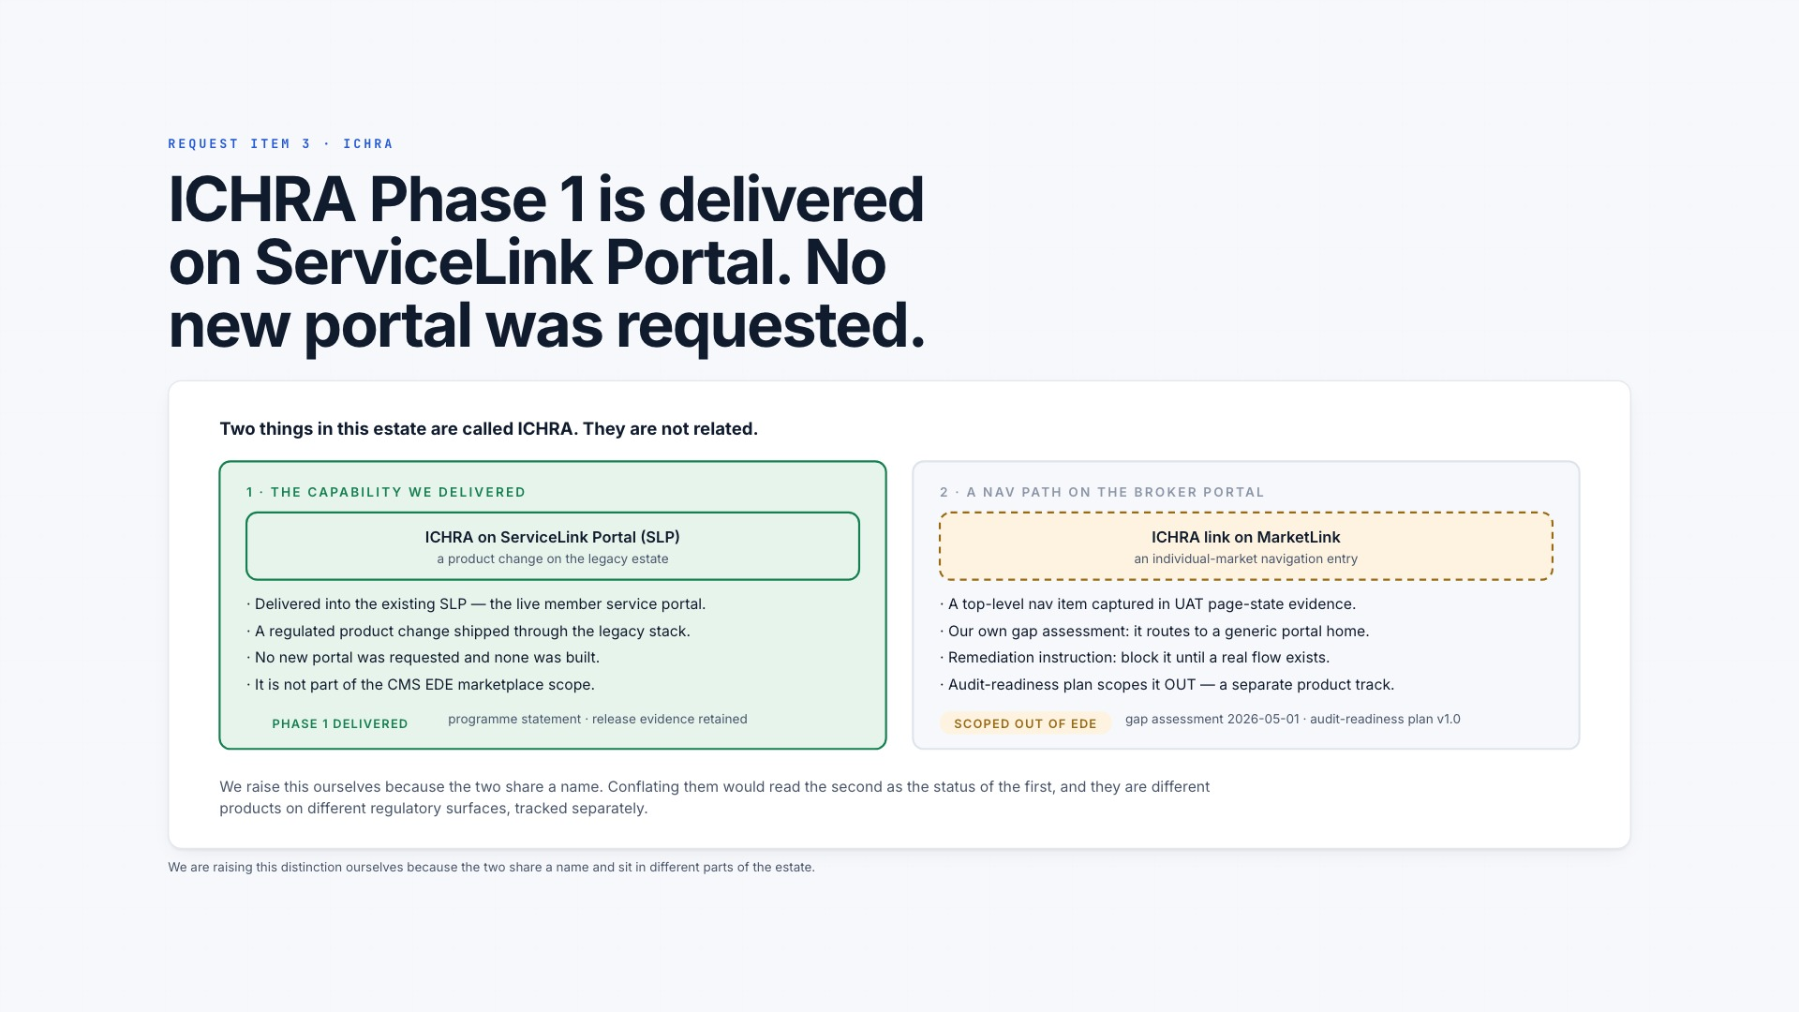
Notes:
[Sources]
- Web presentation slide 20 of 32: /ai-factory-leadership-review.html#ichra
- WHPS AI Transformation programme-owner record: repository CLAUDE.md
- WHPS ServiceLink Portal and ICHRA Phase 1 programme record in this repository

Slide 21
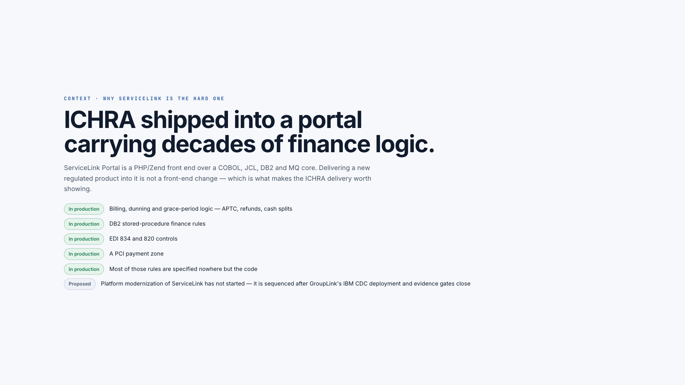
Notes:
[Sources]
- Web presentation slide 21 of 32: /ai-factory-leadership-review.html#servicelink
- WHPS AI Transformation programme-owner record: repository CLAUDE.md
- WHPS ServiceLink Portal and ICHRA Phase 1 programme record in this repository

Slide 22
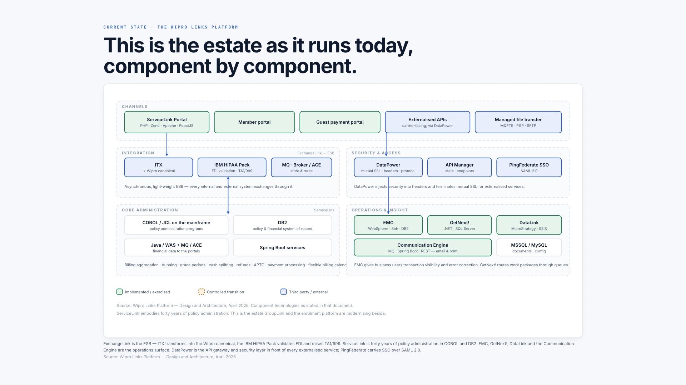
Notes:
[Sources]
- Web presentation slide 22 of 32: /ai-factory-leadership-review.html#sl-arch
- WHPS AI Transformation programme-owner record: repository CLAUDE.md
- WHPS ServiceLink Portal and ICHRA Phase 1 programme record in this repository

Slide 23
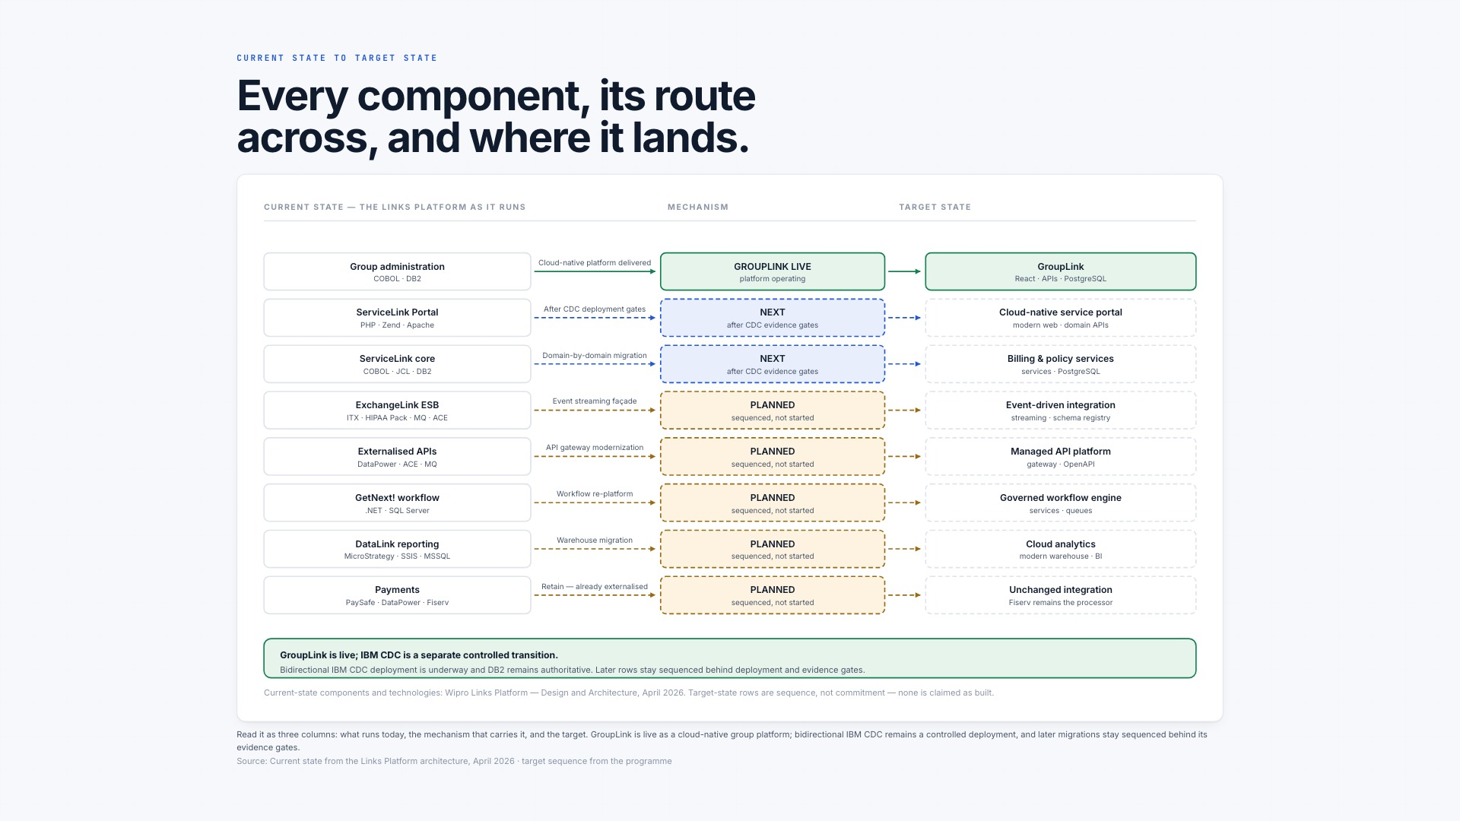
Notes:
[Sources]
- Web presentation slide 23 of 32: /ai-factory-leadership-review.html#legacy-to-target
- WHPS AI Transformation programme-owner record: repository CLAUDE.md

Slide 24
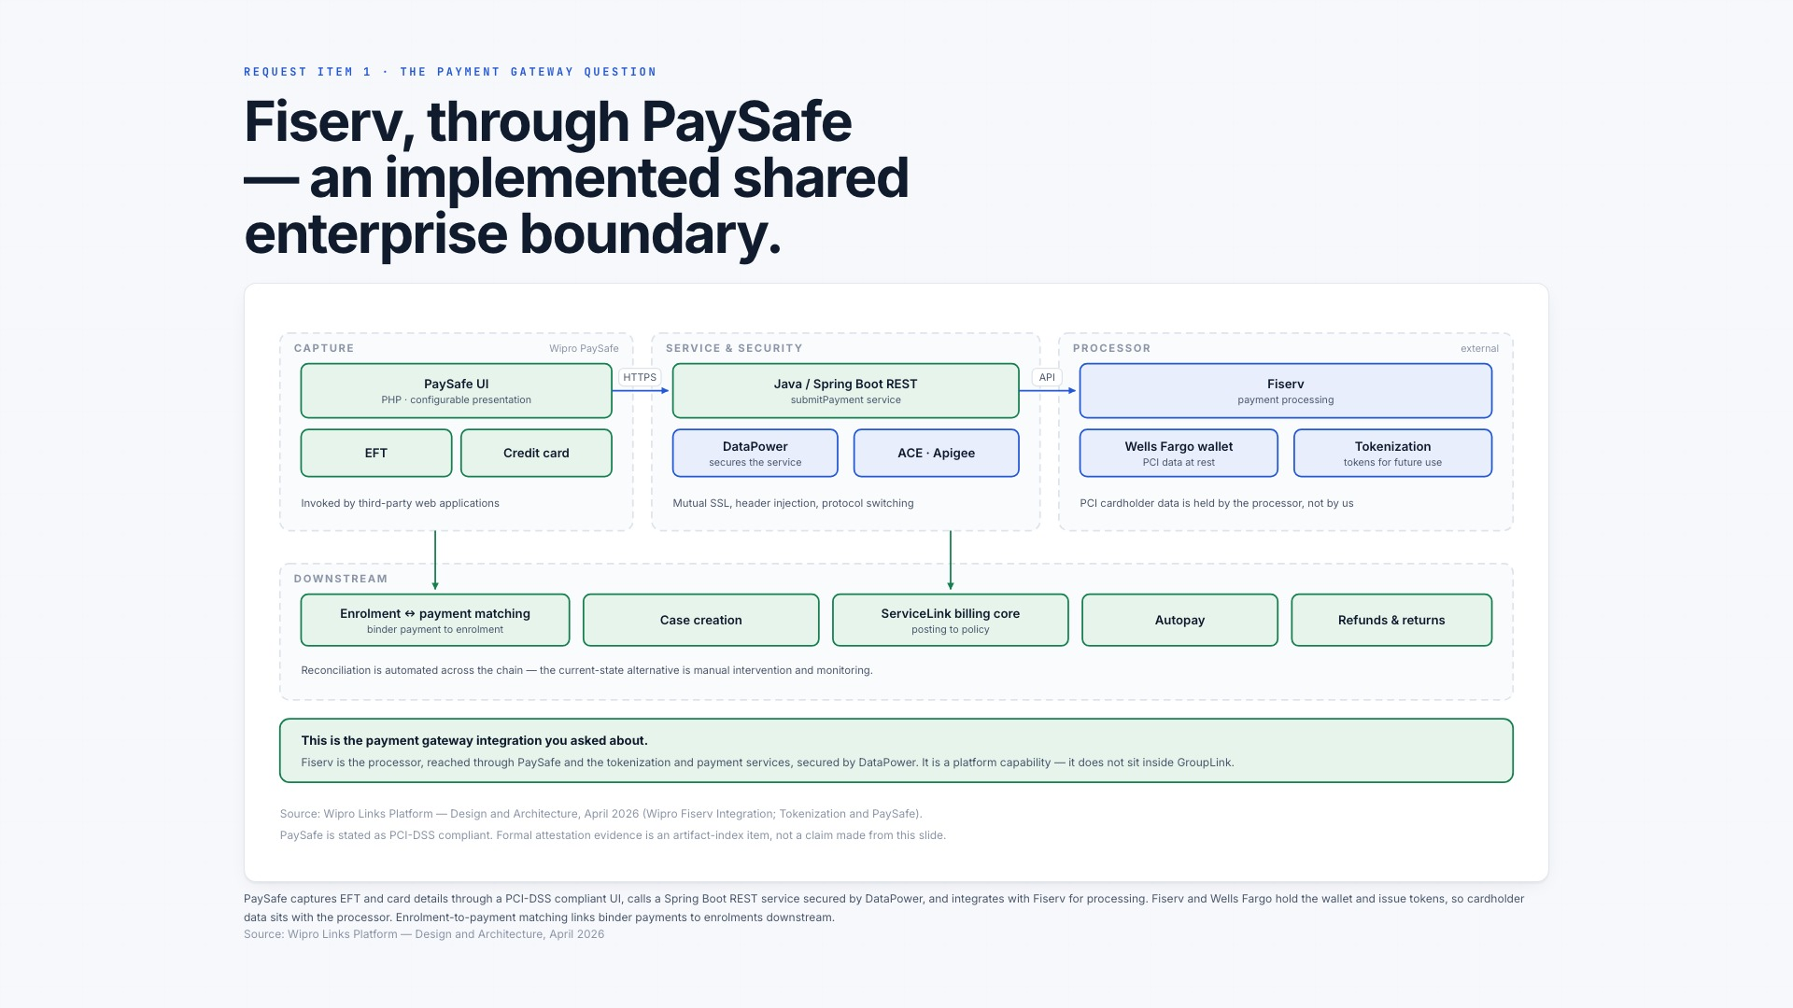
Notes:
[Sources]
- Web presentation slide 24 of 32: /ai-factory-leadership-review.html#payments
- WHPS AI Transformation programme-owner record: repository CLAUDE.md
- WHPS GroupLink architecture and integration record in this repository

Slide 25
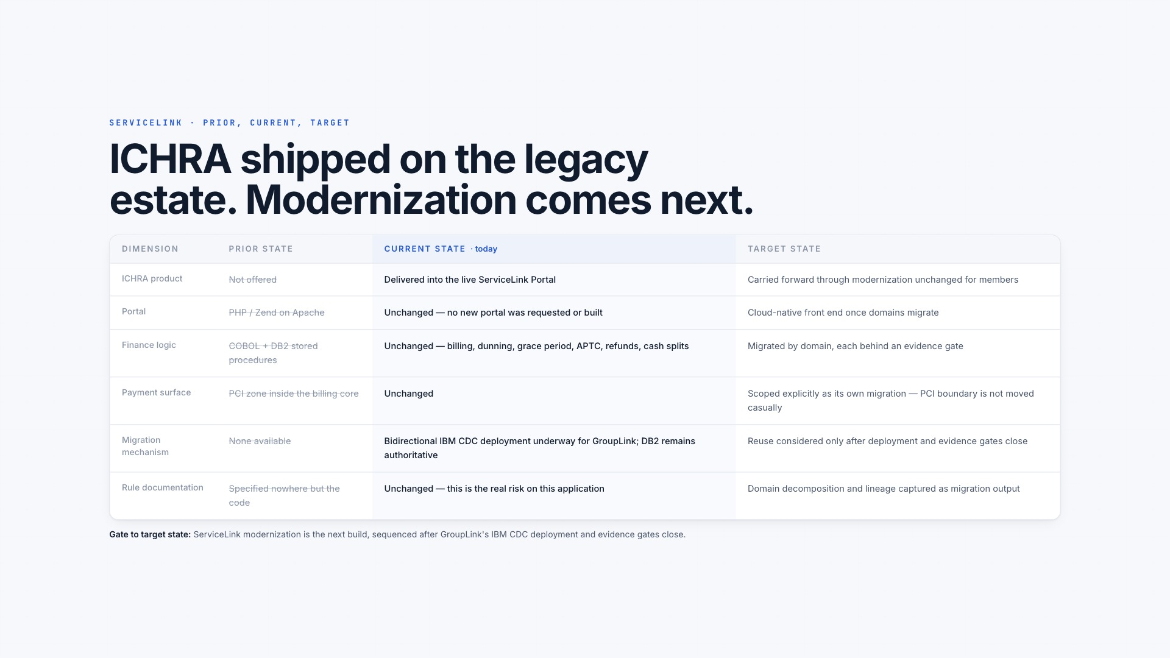
Notes:
[Sources]
- Web presentation slide 25 of 32: /ai-factory-leadership-review.html#sl-shift
- WHPS AI Transformation programme-owner record: repository CLAUDE.md
- WHPS ServiceLink Portal and ICHRA Phase 1 programme record in this repository

Slide 26
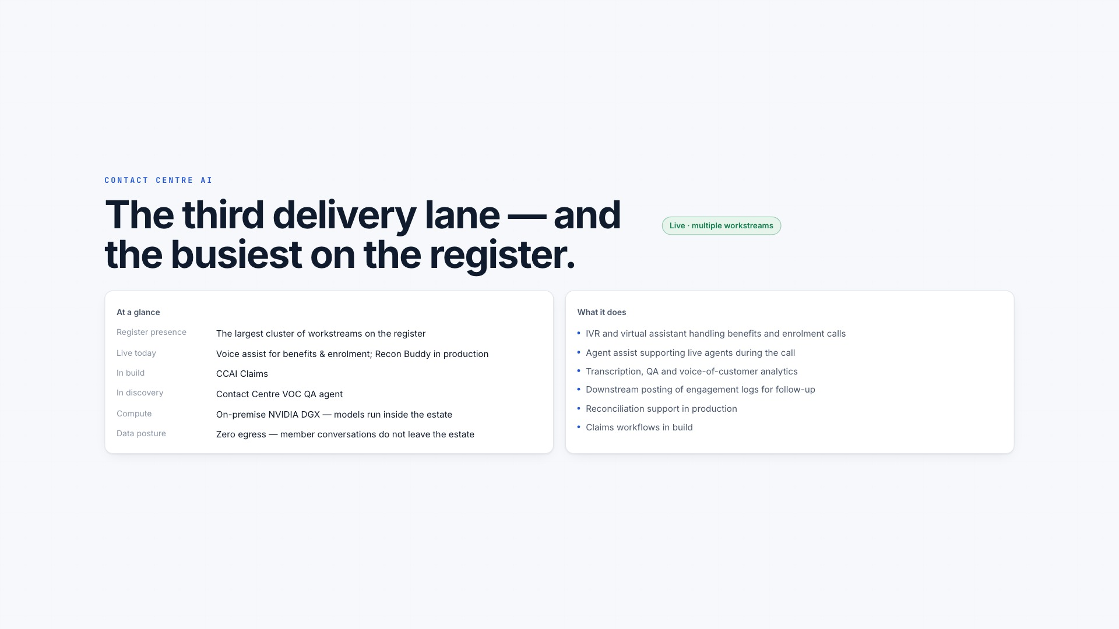
Notes:
[Sources]
- Web presentation slide 26 of 32: /ai-factory-leadership-review.html#cc-overview
- WHPS AI Transformation programme-owner record: repository CLAUDE.md

Slide 27
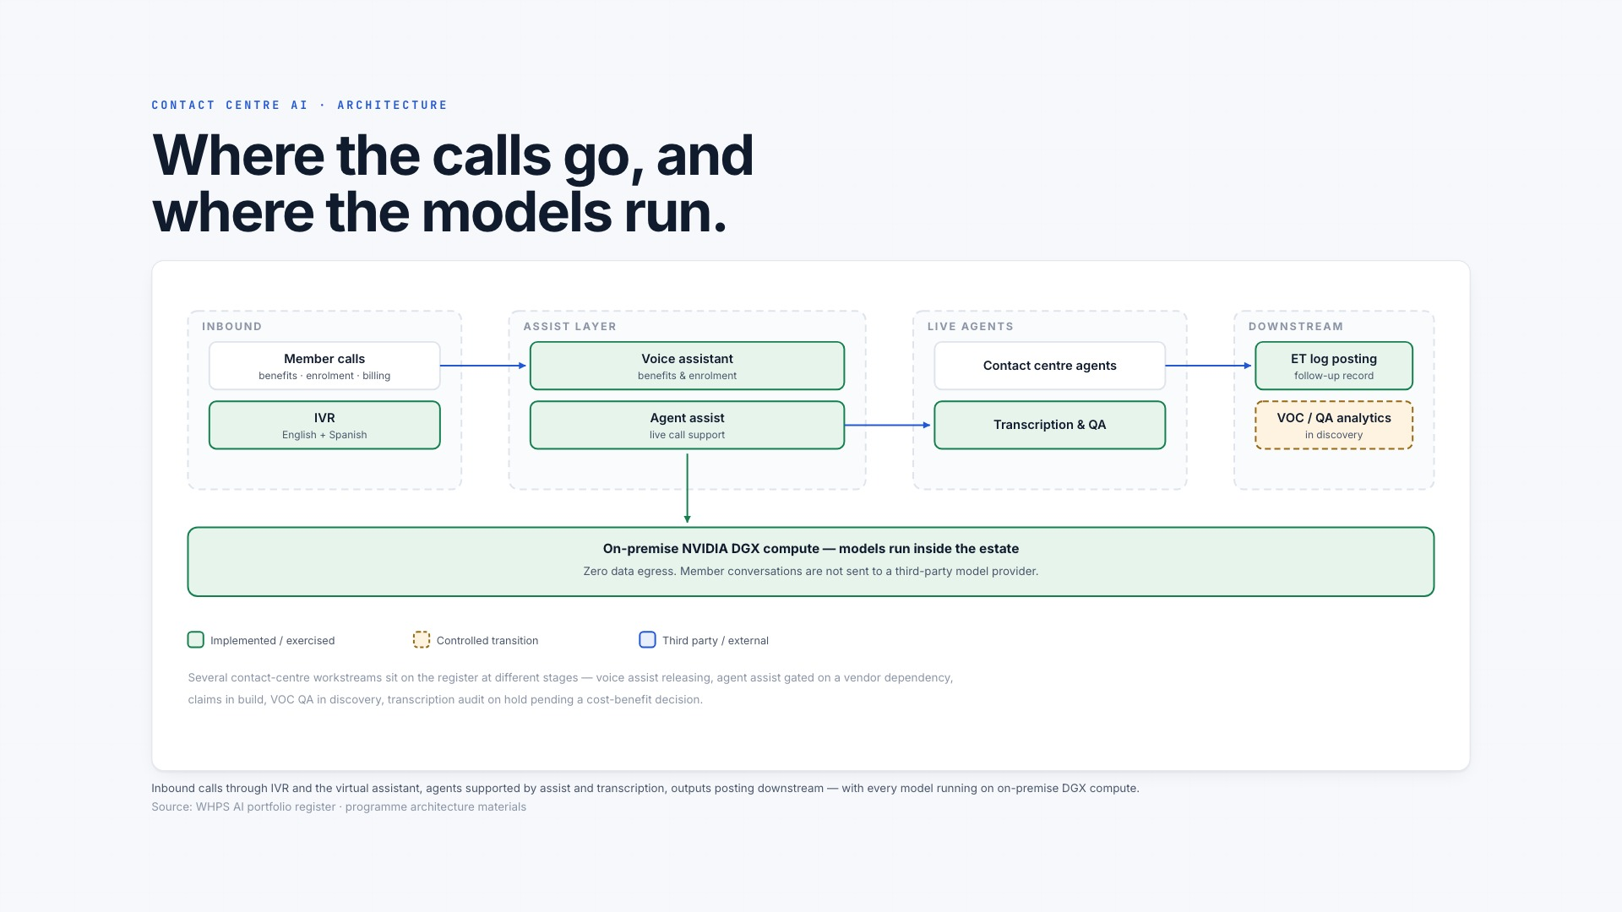
Notes:
[Sources]
- Web presentation slide 27 of 32: /ai-factory-leadership-review.html#cc-arch
- WHPS AI Transformation programme-owner record: repository CLAUDE.md

Slide 28
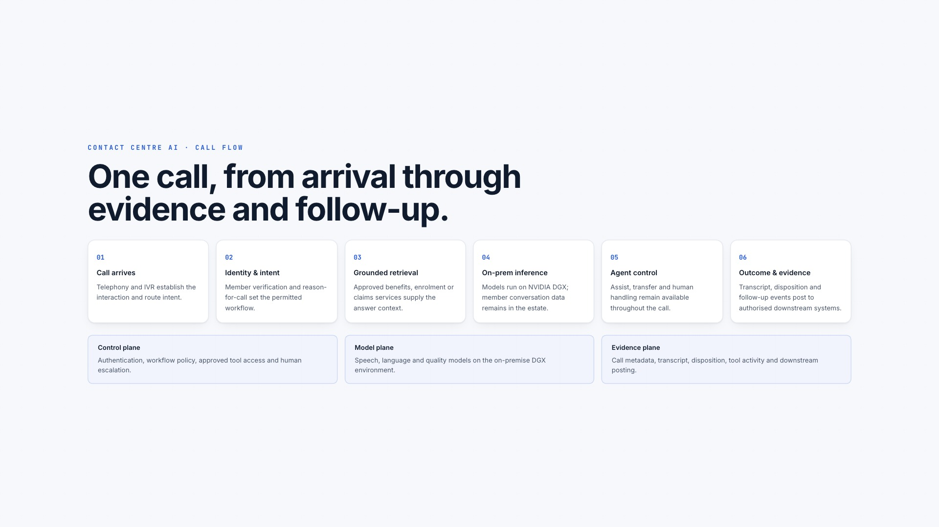
Notes:
[Sources]
- Web presentation slide 28 of 32: /ai-factory-leadership-review.html#cc-flow
- WHPS AI Transformation programme-owner record: repository CLAUDE.md

Slide 29
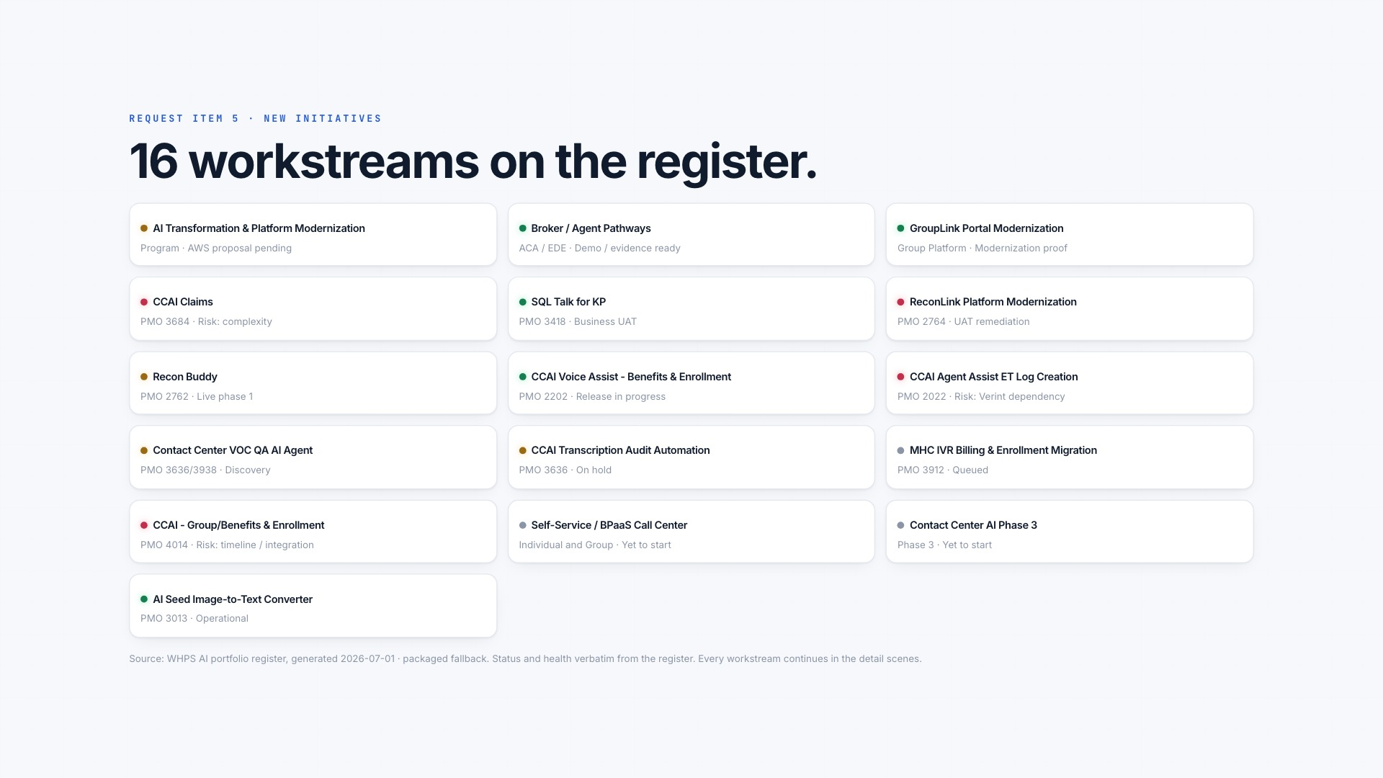
Notes:
[Sources]
- Web presentation slide 29 of 32: /ai-factory-leadership-review.html#initiatives
- WHPS AI Transformation programme-owner record: repository CLAUDE.md

Slide 30
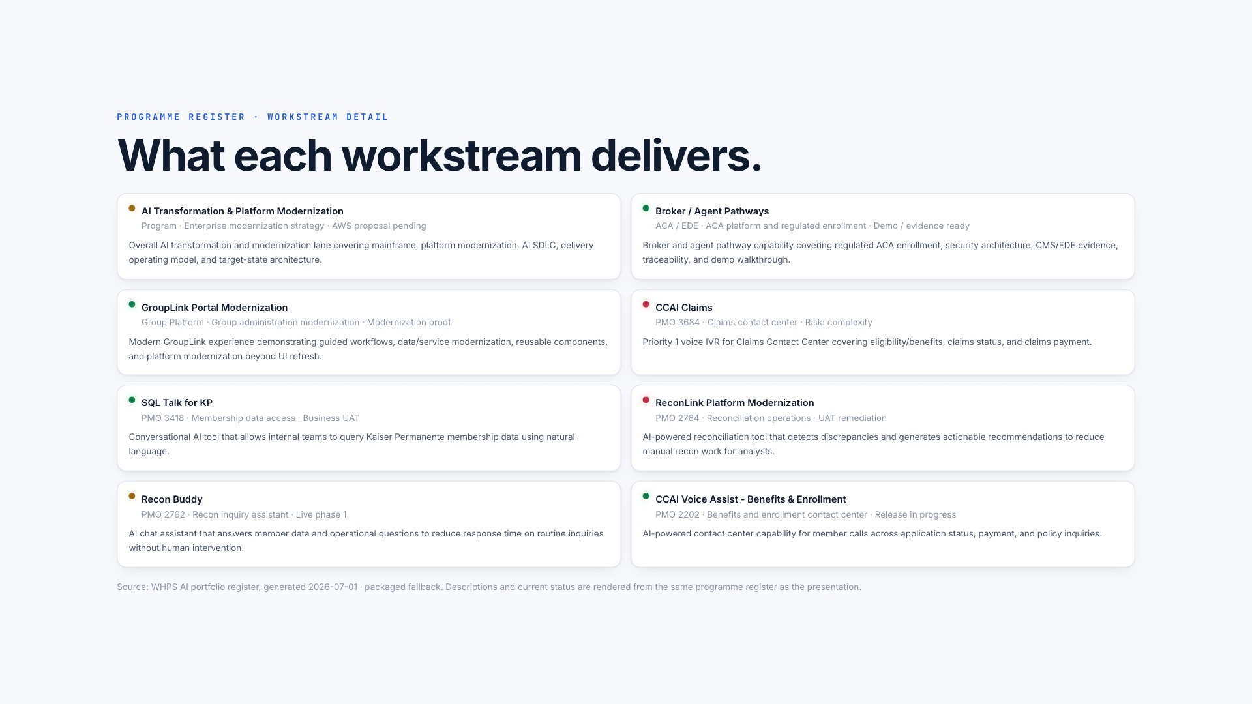
Notes:
[Sources]
- Web presentation slide 30 of 32: /ai-factory-leadership-review.html#initiative-detail-1
- WHPS AI Transformation programme-owner record: repository CLAUDE.md

Slide 31
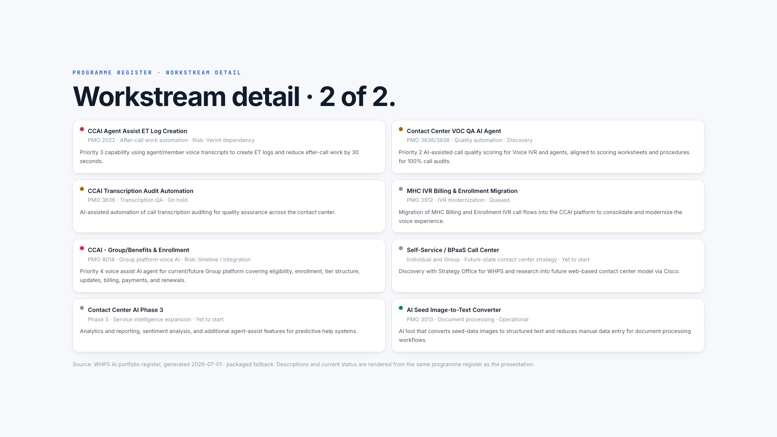
Notes:
[Sources]
- Web presentation slide 31 of 32: /ai-factory-leadership-review.html#initiative-detail-2
- WHPS AI Transformation programme-owner record: repository CLAUDE.md

Slide 32
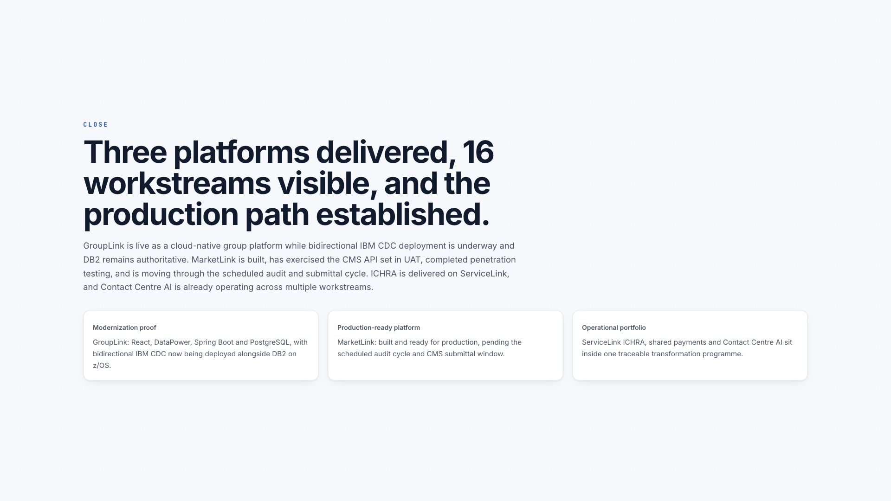
Notes:
[Sources]
- Web presentation slide 32 of 32: /ai-factory-leadership-review.html#close
- WHPS AI Transformation programme-owner record: repository CLAUDE.md

